Slide 1


Introduction
ACCESSDATA® FORENSICS
Regular Expressions
Forensic Analysis
Incident Response
eDiscovery
Information Assurance

Slide 2
Module Objectives
What is a regular expression ?
Learn 10 words to speak this language
Operator vs. Literal
Sets
Function Groups and Curly Things
Interpret and Write Expressions
Editing Expressions in FTK
What is a TR1 Expression?
How to use TR1 Expressions on Index Tab
Notes:
This module provides the information required to perform the following tasks:
Define a regular expression and demonstrate the usefulness of RegEx in FTK;
Understand basic operators and literals in RegEx
Learn 10 very useful special characters that will enable the user to write hundreds of useful expressions.
Interpret and create a basic regular expression.
Integrate a new RegEx into FTK for subsequent use.

Slide 3
What is a Regular Expression ?
Also referred to as RegEx
Provides an efficient way to search for variable patterns in large amounts of data
FTK uses the RegEx ++ search engine
Notes:
Regular expressions is an expression allow forensics analysts to search through large quantities of information for patterns of data such as the following:
• Telephone numbers
• Social Security numbers
• Computer IP addresses
• Credit card numbers
This data can be extracted because it occurs in known patterns. For example, credit card numbers are typically 16 digits in length and are often stored in the following pattern: xxxx-xxxx-xxxx-xxxx.
The use of a regular Expression search engine in FTK is an efficient way for the user to search through large quantities of data for particular strings that are variable yet
Follow a predictable pattern.
The regular expression search engine used by AccessData® Forensic Toolkit® (FTK®) is called Regex++. It was created by Dr. John Maddock, a contributor to www.boost.org. http://www.boost.org/doc/libs/1_41_0/libs/regex/doc/html/boost_regex/syntax/perl_syntax.html
See http://www.boost.org/doc/libs/1_41_0/libs/regex/doc/html/boost_regex/syntax/perl_syntax.html
for a definitive reference on the syntax employed by Regex++, the regular expression search engine bundled with FTK.

Slide 4
Operator vs. Literal
Functional vs. Inert
“Act on it” vs. “Show it”
Most characters are literal by themselves
  x returns x d returns d
Notes:
In an expression in the RegEx “language” characters can represent themselves (as a literal) or characters can be operators. Operators tell the search engine to act on an affected portion of the expression in a certain way much like the plus sign in the simple mathematical expression “ 2 + 2 ” tells us to add the values together.
Most characters are considered literal by themselves. A search for a literal character tells the search engine to locate and display (return) that character. If a character is a literal by default, a search for that character will return that character. For example a search for the literal “x” will return all of the “x” characters and a search for the literal “d” will return all of the “d” characters.

Slide 5
Operator vs. Literal
The “escape character” ( \ ) changes that:
These characters are literals by themselves
x returns x d returns d
But they change to operators by adding “\”.
\x returns hex byte \d returns a digit

Slide 6
Operator vs. Literal
Some are operators by themselves
  - (hyphen) functions as a range delimiter
  ? Match preceding thing one or no times
  . (period) wildcard –match any one thing
But they change to literals by adding “\”.
  \- returns - \? returns ? \. returns .
Notes:
Some characters represent operators when used by them selves. Again, operators tell the search engine to act on an affected portion of the expression in a certain way. For example the hyphen character, ( - ), tells the search engine to look for things in a range of the characters on either side of the hyphen. For example, a search for the string “ a-d “ would tell the search engine to search for and display any character in the range from a to d, returning a, b, c, or d.
The question mark character ( ? ) is a special operator that tells the search engine to return whatever is immediately before the question mark, one or zero times. If an examiner wanted to search for all the instances of the two phrases “big dog” or “dog” the expression might look like this: “ (big)?dog “ The instance of the word big would precede the word dog one or zero times and the search engine would return all of the hits for “big dog” and “dog”.
The period character ( . ) is a special operator that represents any one character. Think of it as a wildcard. A search for the term “ .7 “ would return hits such as a7, b7, z7, 17, 97, 07 and so on. This operator, the period, can be useful when part of a sought-after string is predictable but other characters in the string are not.
Just as the escape character changed some literals to special operators, it changes operators into literals.

Slide 7
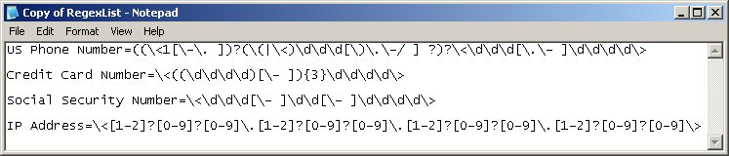
Sets
Sets define a range of characters
A set is delimited by brackets -- ‘[ and ]’
FTK matches any single character that is a member of the given set.

Slide 8
Character Classes
. matches anything !
\d matches decimal digits
\x represents a HEX character

Slide 9
Function Groups
Group expressions together:
Example: The pattern of four digits \d\d\d\d and a pattern of a ‘-’ or ‘ ’ can be combined within `( and )`

Slide 10
Curly Things
Match an expression or set of expressions an arbitrary number of times.
Example: (4 digits followed by a ‘-’ or ‘ ’)
This (expression) must occur {three times}

Slide 11
Sample Expressions
\< The start of a word
\> The end of a word
? Match 1 or 0 preceding instances
| This | That
Let’s decipher US Phone Numbers

Slide 12
10 “New Words”
\< The start of a word
\> The end of a word
| This | That
? Match 1 or 0 preceding instances
Range delimiter
[ ] Set- match any one thing inside
. Match any one thing
{ n } Do the preceding thing n times
\d return any decimal digit 0 thru 9
\x define a hex a hex byte 00 thru ff

Slide 13
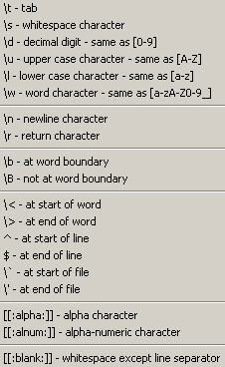
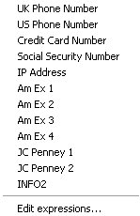
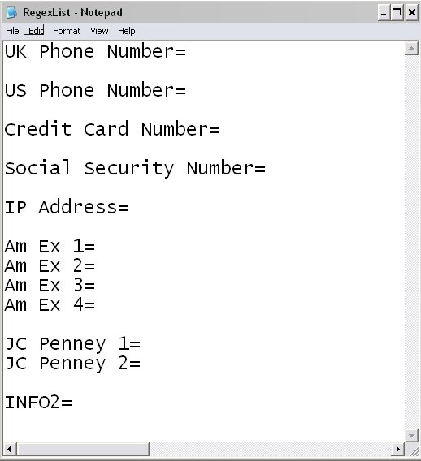
Editing Expressions
From the FTK Live Search Tab

Slide 14
TR-1 Expressions on Index Tab
New Functionality in FTK 3.x
TR1 Expressions can be used on Index Tab for instant results
Similar to RegEx++ Expressions
dtSearch does not support RegEx++

Slide 15
TR-1 Expressions on Index Tab
TR1 Syntax Rules
  Can only be used for a single whole word
  Expression must be quoted and begin with ## ie. “##\d\d\d\d”
  Letters, numbers and some special characters are searchable*
  dtSearch does not store line breaks and other characters so beginning/end of line searches won’t work.

Slide 16
TR-1 Expression Examples
Apple and “##1999[0-9]” will find Apple and 1990 through 1999.
“##\d{16}” will return 16 digits.
“##mari.uana” will return marijuana and marihuana
“##.{1,}@gmail” will find all gmail addresses
“##.{1,}@.{1,}” will find all email addresses

Slide 17
TR-1 Expressions
References for more expressions
  http://msdn.microsoft.com/en-us/library/bb982727.aspx

Slide 18
Module Review
What is a regular expression ?
Learn 10 words to speak this language
Operator vs. Literal
Sets
Function Groups and Curly Things
Interpret and Write Expressions
Editing Expressions in FTK
How to use TR1 Expressions on Index Tab

Slide 19



